Slide 1
SPL-1 Presentation “Snake Game”
Presented by: Md. Rashid shabab Nihal
Roll : BSSE-1136
EXAM ROLL: 1137
Supervisor: Kishan Kumar Ganguly

Slide 2
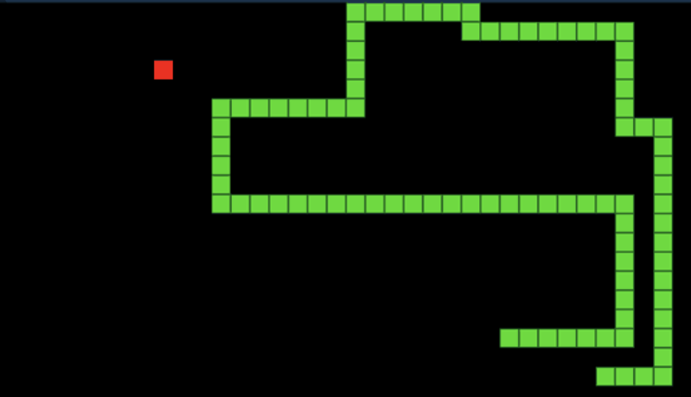
The first design of snake game was introduced in 1976 and we were introduced to the game through a number of different platforms. In this project, I am willing to design a snake game using C/ C++.
Simple Snake game

Slide 3
Project description
Snake is a very basic and popular game worldwide. The game would be for a solo user and some features are mentioned here:
The player would control a dot, square, or object on a bordered plane.
In this game, the end of the trail would be in a fixed position, so the snake would continually get longer as it moves.
Each match would end when the snake runs into the screen border, other obstacle, or itself.

Slide 4
Scope
Can be best choice as stress relieving game in the busy life pattern of the people in present life.
Simplicity and efficiency is the main fact that we get using the C++ programming language.

Slide 5
Challenges
Building the user interfaces in C++ as the game is already very popular.
The game only offers a text-based interface, which is not very user-friendly interface
Making the user interface faster since the system is implemented in Manual, the response is very slow.

Slide 6
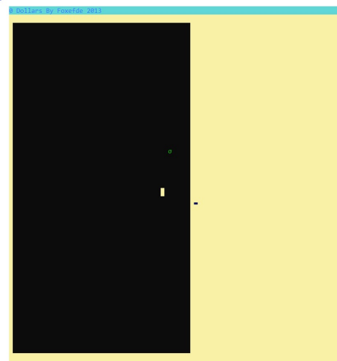
User Manual
When a user run the project, he/she will see the User Interface
This is the starting stage of the game.The snake is smaller in size now.it will slowly get bigger in size by taking the food.after it takes one food,another food will show up then the snake will eat another food

Slide 7
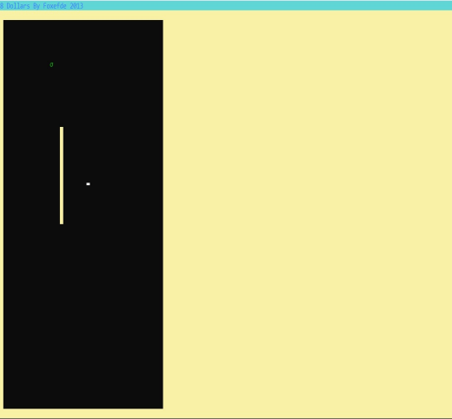
User Manual
Here we can see the snake get large in size.and it will get more larger bytaking food..its size will continuously getbig till it takes food.

Slide 8
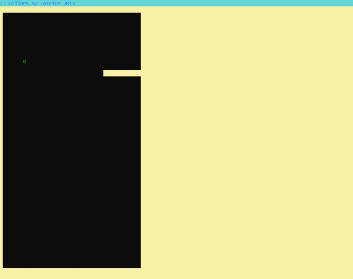
User Manual
The snake will die if it hits the wall.the game will be over.then the score will show on.

Slide 9
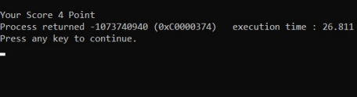
User Manual
After the game is over or the snake dies and we will see the score.

Slide 10
Thank you for your consideration

